Slide 1
Data Migration From Excel to PPT
Team Name: Team43_Automation
Teammates:
M.Devi Sowmya
V.Gayatri
G.Sri Sai Vikas
S.Chandrika Aishwarya
P.Haritha
188W1A1232
188W1A12B2
188W1A1219
188W1A12A5
188W1A1299

Slide 2
Motivation
Many Organizations need to create PPT on regular basis which is a repetitive process.
This often becomes uncreative and routine task.
Developing a BP Solution where we can automate this process will be beneficial to organizations.
This also eliminates extra efforts by humans and those can be invested in some other domains

Slide 3
Problem Statement
One of the organizations which needs to create PPTs regularly is APGENCO Power Plant Vijayawada(Dr.NTTPS). This organization should make a presentation at the end of each month in order to review the operations of that month(Operation Review Team).
For this they need to present the resource utilization in form of graphs, tables and description for better visualizations
The main motive of the problem is to summarize data from Excel in the form of Power Point Presentation(PPT).It includes various tables, Calculations and Graphical Representations

Slide 4
Big Picture
To automate PowerPoint Presentations Blue Prism doesn’t have any inbuilt VBO
To overcome this problem we used the Vuram presentation VBO published on BluePrism's official website.However It doesn’t contain all the features like adding tables, images
Moreover, drawing charts in PPT is not robust enough while automating.
For this reason integrating Blue Prism with other Programming Languages has become essential.

Slide 5
Proof Of Concept
Now-a-days, every domain creates PPT for many reasons.
Users need to use other applications to create charts.
Also when the same template is used frequently. Their work is just filling the data at right slots, which becomes redundant.
Since the project is around creating tables, charts via Blue Prism and using the template that is defined by client, The scope of the project is wide.

Slide 6
TOOLS/TECHNOLOGIES
Vuram Power Point VBO - Open, Add Slides, Close and Save PPT
Microsoft Office - Microsoft Excel, Microsoft PPT
Python 3 - To draw charts that are pasted in PPT
File Management VBO - Used by Power point VBO to access files in system
Collections VBO - To manipulate Collections in Blue prism
Command Prompt - To Run the python code.

Slide 7
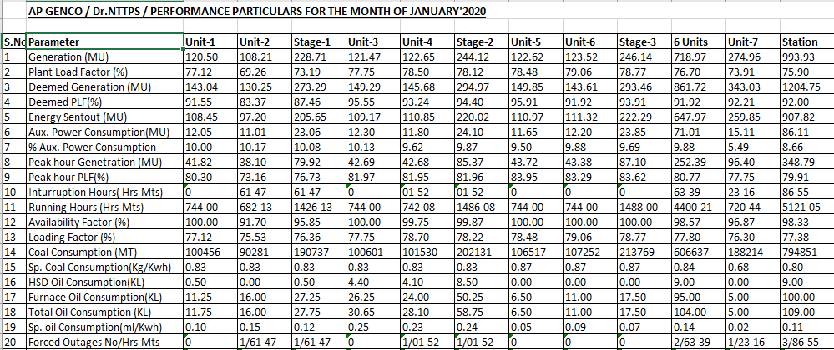
Solution
Dataset
Various Parameters are displayed in Excel sheet separated by Units, Stages, Station.

Slide 8
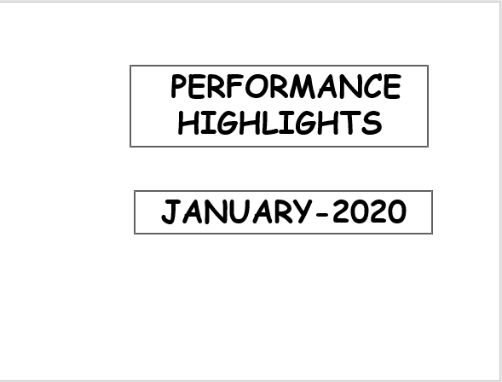
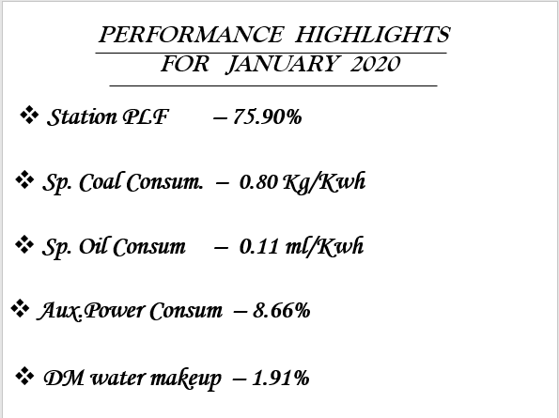
Expected Output

Slide 9
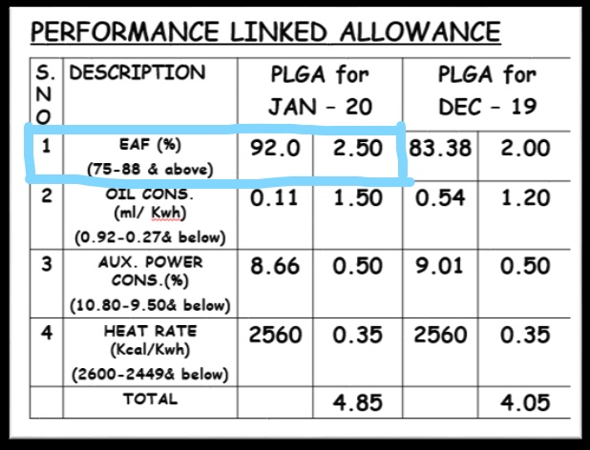
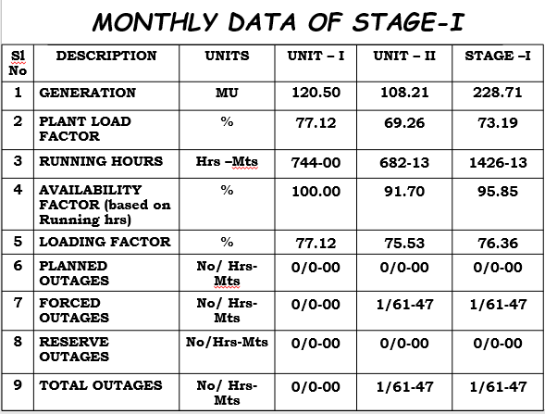
Tables in Slides
EAF = (Auxilary Power Consumption+Shortfallof generation due to reverse outage)*100/(Capacity)
= 92.0
The allowance(2.50) of EAF is based on the value of above calculation. The table is shown in next slide

Slide 10
Output Explanation
The output in PPT contains various tables, headings, Dates, Calculations, Bullet Points, Charts etc
The Allowance based on EAF:
Similarly for other parameters also there will be Calculations and tables.
EAF in Month | Rate Of Allowance
75 | 1.2
76 | 1.3
77 | 1.4
78 | 1.5
79 | 1.6
80 | 1.7
81 | 1.8
EAF in Month | Rate Of Allowance
82 | 1.9
83 | 2.0
84 | 2.1
85 | 2.2
86 | 2.3
87 | 2.4
88 and Above | 2.5

Slide 11
Drawing Charts using Python
The Python Code is invoked from Command Prompt.
The Python Code takes command line arguments and displays a Pie-Chart according to it
This arguments are passed from Blue Prism.
The Python code generates “.png” file which is later written into PPT

Slide 12
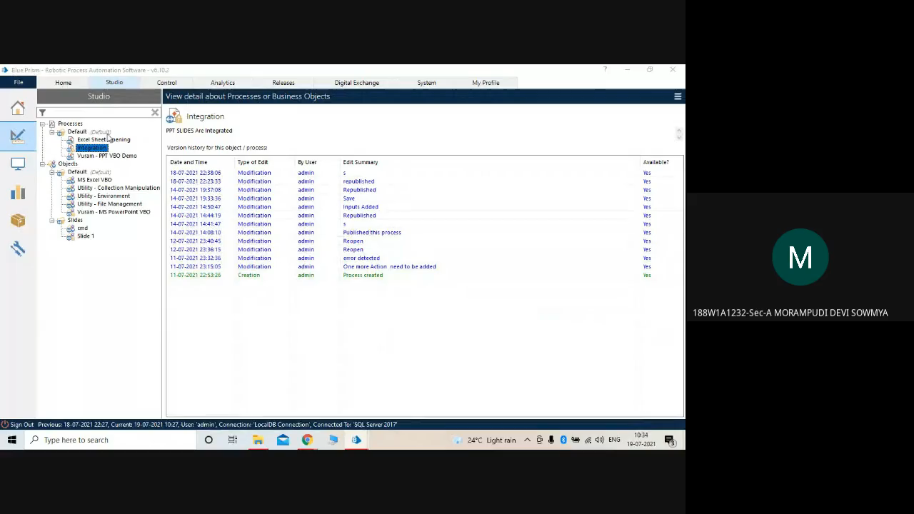
Working Demo
Please Refer the Video file uploaded along with ppt if the video here doesn’t play

Slide 13
Challenges Faced
Since the organization provided us with partial data. We have shown an example for all formats, the organization needs the data in PPT.
The major difficulties faced during the project are adding the VB code to generate a table. However The microsoft's documentation helped us overcome this difficulty with some useful functions.

Slide 14
Conclusion
Hence presentation is a common process in most of the organizations we automate that process by using vuram ppt VBO and by adding some extensions to that VBO
Future Scope
Provided a decent amount of Data, The project can expand it’s wings to Machine Learning Models which can be used to predict the data in Future and draw appropriate visualizations
The meetings can also have the Machine Learning model’s opinion to take into consideration while taking any important decisions

Slide 15


